Slide 1
Cosmos DB Workshop https://aka.ms/cosmosdb-workshop
Twitter: @RayKao Email: ray.kao@microsoft.com
Ray Kao
Open Source Software Data Lead
Azure Global Black Belt
Microsoft Canada

Slide 2



OSS Canada Leadership Team
CanadaOpenSource@Microsoft.com
Noureen Syed
OSS Business Lead
Azure Cloud & Enterprise
Noureen.Syed@Microsoft.com
Ray Kao
OSS Cloud Native Data Lead
Azure Global Black Belt
Ray.Kao@Microsoft.com
Kevin Harris
OSS Cloud Native Dev Lead
Azure Global Black Belt
Kevin.Harris@Microsoft.com

Slide 3


Azure Cosmos DB
A globally distributed, massively scalable, multi-model database service
Elastic scale out
of storage & throughput
Guaranteed low latency at the 99th percentile
Five well-defined consistency models
Turnkey global distribution
Comprehensive SLAs

Slide 4
Azure Cosmos DB
A globally distributed, massively scalable, multi-model database service
Column-family
Document
Key-value
Graph
Elastic scale out
of storage & throughput
Guaranteed low latency at the 99th percentile
Five well-defined consistency models
Turnkey global distribution
Comprehensive SLAs

Slide 5


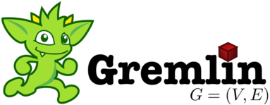
Azure Cosmos DB
A globally distributed, massively scalable, multi-model database service
MongoDB
Table API
Column-family
Document
Key-value
Graph
Elastic scale out
of storage & throughput
Guaranteed low latency at the 99th percentile
Five well-defined consistency models
Turnkey global distribution
Comprehensive SLAs

Slide 6

What sets Azure Cosmos DB apart

Slide 7
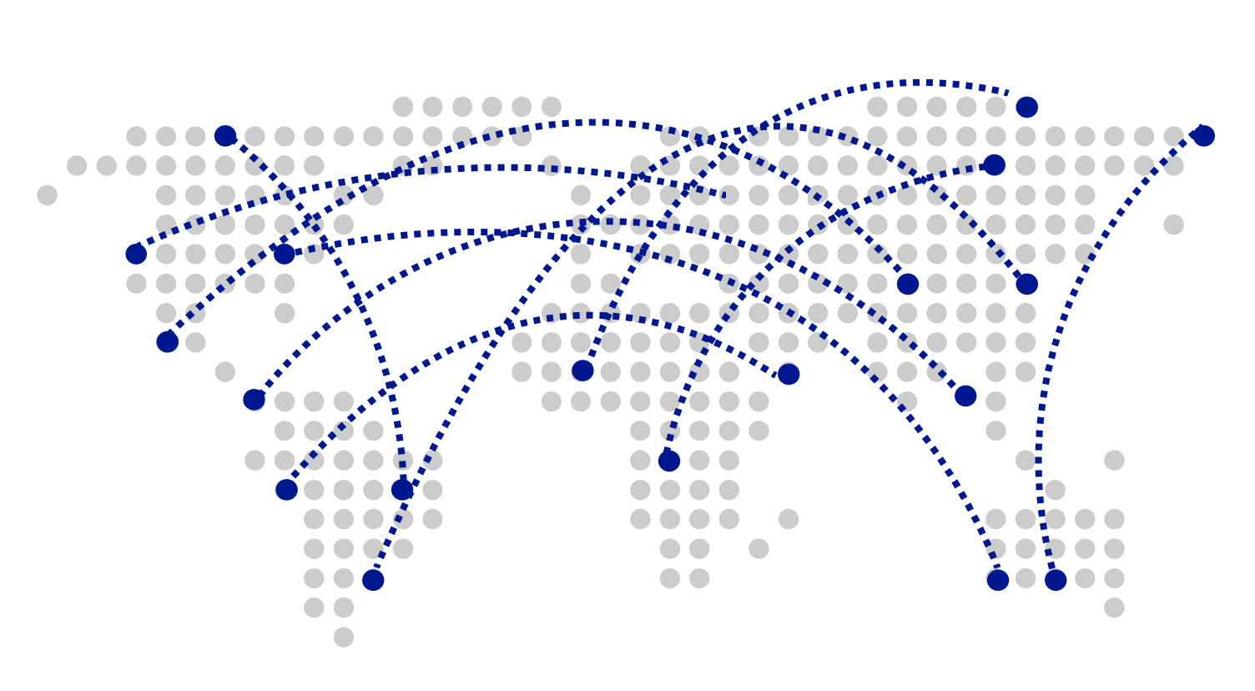
Turnkey Global Distribution
Worldwide presence as a Foundational Azure service
Automatic multi-region replication
Multi-homing APIs
Manual and automatic failovers
Designed for High Availability

Slide 8
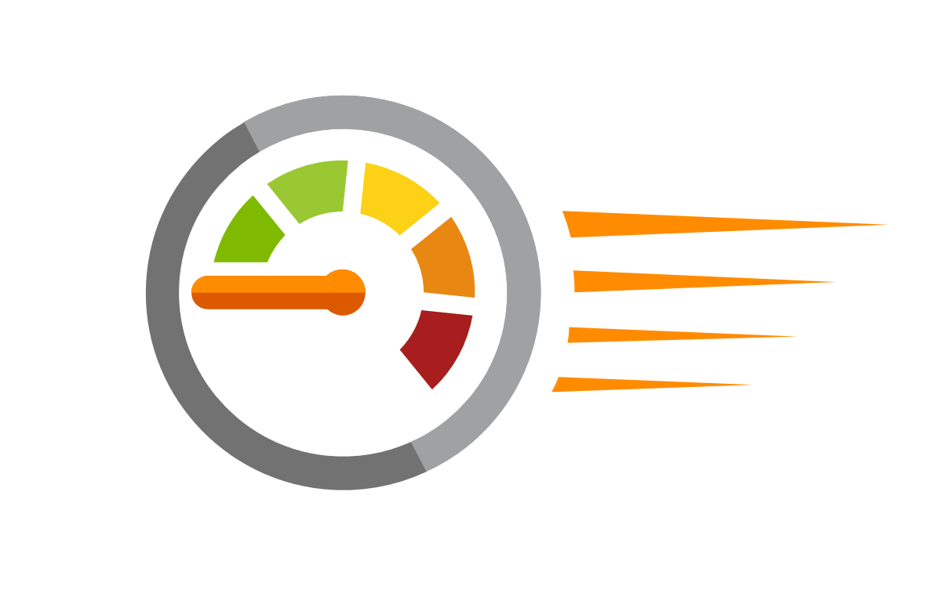
Guaranteed low latency at P99 (99th percentile)
Requests are served from local region
Single-digit millisecond latency worldwide
Write optimized, latch-free database engine designed for SSD
Synchronous automatic indexing at sustained ingestion rates
Reads
(1KB)
Indexed writes
(1KB)
P50
<2ms
<6ms
P99
<10ms
<15ms

Slide 9
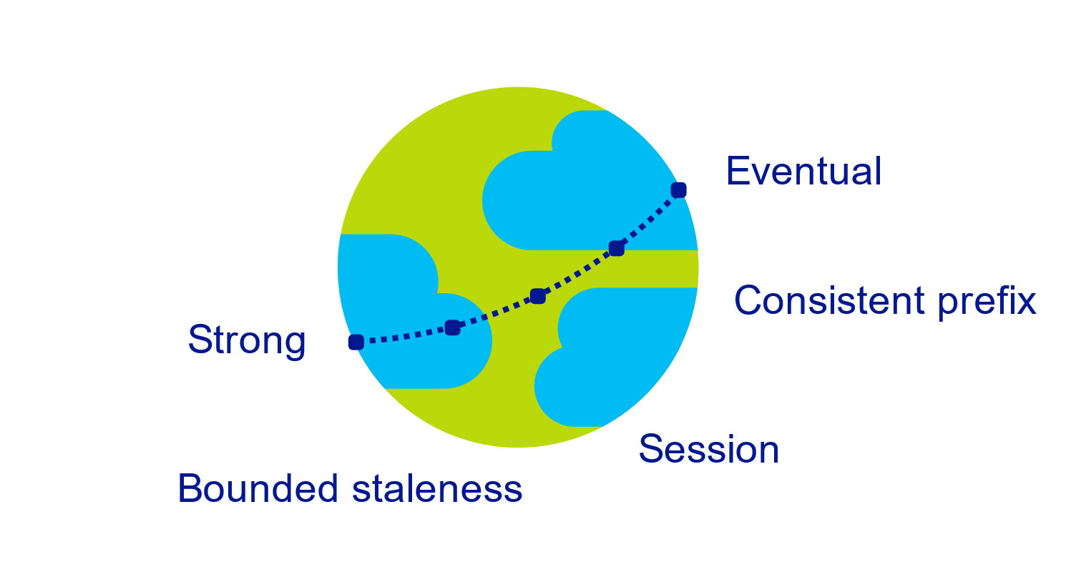
Multiple, well-defined consistency choices
Global distribution forces us to navigate the CAP theorem
Writing correct distributed applications is hard
Five well-defined consistency levels
Intuitive and practical with clear PACELC tradeoffs
Programmatically change at anytime
Can be overridden on a per-request basis

Slide 10

Elastically scalable storage and throughput
Single machine is never a bottle neck
Transparent server-side partition management
Elastically scale storage (GB to PB) and throughput (100 to 100M req/sec) across many machines and multiple regions
Automatic expiration via policy based TTL
Pay by the hour, change throughput at any time for only what you need
12000000
10000000
8000000
6000000
4000000
2000000
Black Friday
Provisioned request / sec
Nov 2016
Dec 2016
Time
Hourly throughput (request/sec)

Slide 11
Schema-agnostic, automatic indexing
At global scale, schema/index management is painful
Automatic and synchronous indexing
Hash, range, and geospatial
Works across every data model
Highly write-optimized database engine
Schema
Physical index

Slide 12
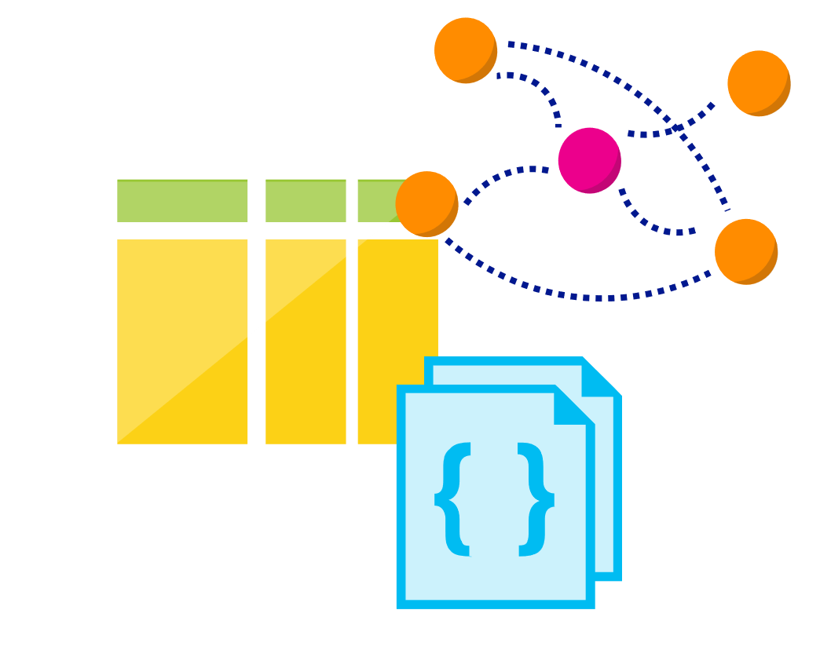
Multi-model, multi-API
Database engine operates on Atom-Record-Sequence type system
All data models can be efficiently translated to ARS
Multi-model: Key-value, Document, Column, and Graph
Multi-API: SQL (DocumentDB), MongoDB, Table, Cassandra and Gremlin
More data-models and APIs to be added

Slide 13
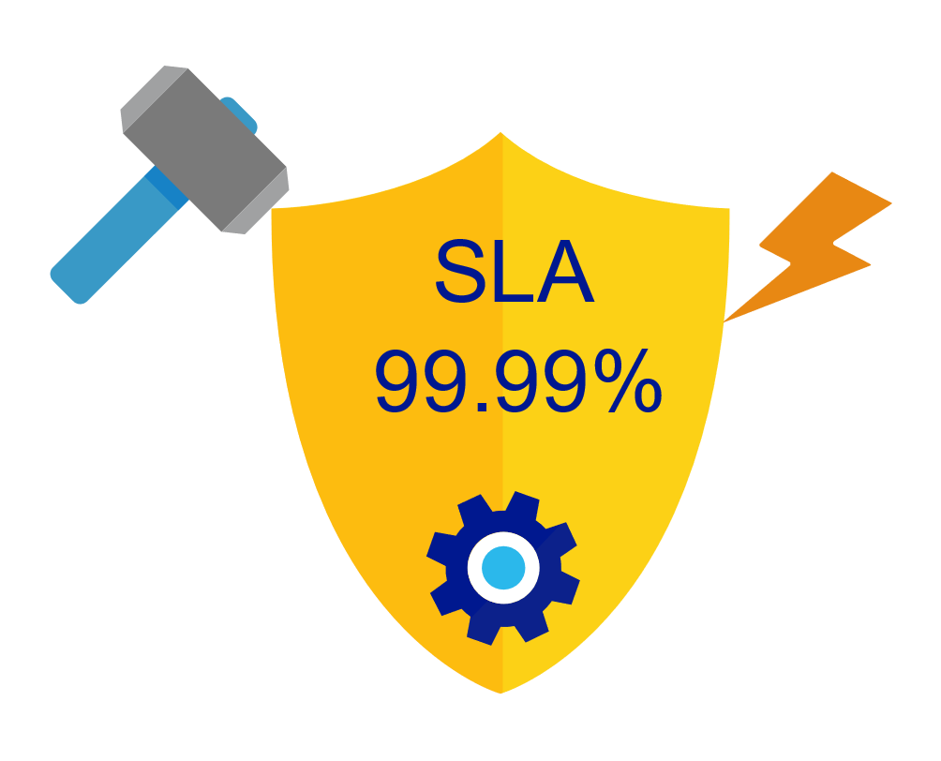
Industry-leading, enterprise-grade SLAs
99.99% availability – even with a single region
Made possible with highly-redundant storage architecture
Guaranteed durability – writes are majority quorum committed
First and only service to offer SLAs on:
Low-latency
Consistency
Throughput

Slide 14

Security & Compliance
Always encrypted at rest and in transit
Encryption@ Rest – AES256
Encryption @ Transit – SSL / TLS
Fine grained “row level” authorization
User/Permissions with Resource Tokens
Network security with IP firewall rules and VNET
Comprehensive Azure compliance certification:
ISO 27001, ISO 27018, EUMC, HIPAA
PCI, SOC1 and SOC2
FEDRAMP, HITRUST

Slide 15
Common Use Cases and Scenarios

Slide 16


Globally Distributed Apps
Business Needs:
High scalability to support massive user base
Low latency access across multiple geographies to build highly responsive applications
Automatic indexing over flexible schemas to support rich queries over user-defined content (e.g. custom form builder)
High availability across multiple data centers

Slide 17




Content Management Systems
Azure region A
Azure Cosmos DB
(app + session state)
Azure region B
Azure Traffic Manager
Globally distributed
across regions
Azure region C

Slide 18





Internet of Things – Telemetry & Sensor Data
Business Needs:
High scalability to ingest large # of events coming from many devices
Low latency queries and changes feeds for responding quickly to anomalies
Schema-agnostic storage and automatic indexing to support dynamic data coming from many different generations of devices
High availability across multiple data centers

Slide 19






Internet of Things – Telemetry & Sensor Data
Azure IoT Hub
Azure Databricks Spark
(Structured Streaming)
Azure Cosmos DB (Hot)
(TTL = 90 days)
Azure API App
(user facing app)
Azure Function
(triggered via Cosmos DB change feed)
Azure Storage (Cold)

Slide 20

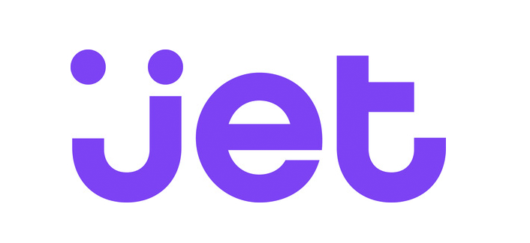



Retail – Product Catalog & Order Processing
Business Needs:
Elastic scale to handle seasonal traffic (e.g. Black Friday)
Low-latency access across multiple geographies to support a global user-base and latency sensitive workloads (e.g. real-time personalization)
Schema-agnostic storage and automatic indexing to handle diverse product catalogs, orders, and events
High availability across multiple data centers

Slide 21

Retail Product Catalogs
Azure Web App
(e-commerce app)
Azure Cosmos DB
(product catalog)
Azure Search (full-text index)
Azure Storage
(logs, static catalog content)
Azure Cosmos DB
(session state)

Slide 22



Retail Order Processing Pipelines
Azure Functions
(E-Commerce Checkout API)
Azure Cosmos DB (Order Event Store)
. . .
Azure Functions
(Microservice 1: Tax)
Azure Functions
(Microservice 2: Payment)
Azure Functions
(Microservice N: Fufillment)

Slide 23

Real-time Recommendations
Online Recommendations Service
Azure Container Service
(Recommendations API)
Azure Cosmos DB
(Product + User Vectors)
Shoppers
E-commerce Store
Apache Spark on
Azure Databricks
Azure Container Service
(Order Transaction API)
Azure Cosmos DB
(Customer Orders)
Order Transactions

Slide 24




Multiplayer Gaming
Business Needs:
Elastic scale to handle bursty traffic on day
Low-latency queries to support responsive gameplay for a global user-base
Schema-agnostic storage and indexing allows teams to iterate quickly to fit a demanding ship schedule
Change-feeds to support leaderboards and social gameplay

Slide 25



Multiplayer Gaming
Azure CDN
Azure Storage
(game files)
Azure API Apps
(game backend)
Azure Cosmos DB
(game database)
Azure Databricks
(game analytics)
Azure Traffic Manager
Azure Functions
Azure Notification Hubs
(push notifications)

Slide 26



Customer 360 + Operational Analytics
Business Needs:
High scalability to handle large user base
Rich queries and automatic indexing over flexible schemas to consolidate data from a variety of sources
Built-in aggregates and efficient spark connector to analyze user behavior, drive insights, and build a single view of the customer.

Slide 27

Customer 360 + Social Analytics
1st-Party and 3rd-Party
Data Sources
Azure Cosmos DB
(Master Data)
Spark on
Azure HDInsight

Slide 28
Scale-out Computation
Spark SQL
Spark Streaming
GraphX (graph)
MLlib (machine learning)
Apache Spark on Databricks
Scale-out Database
Spark Connector using SQL API
Azure Cosmos DB

Slide 29

Messaging
Business Needs:
High scalability to ingest and store messages from a massive user base
Low latency access across multiple geographies to support global user-base
High availability across multiple data centers

Slide 30
Messaging
Week 0
Azure Cosmos DB
(message data – partitioned by userid)
Azure Search
(full-text index)
Azure Web App
(messaging app)

Slide 31
Messaging
Week 0
Azure Cosmos DB
(message data – partitioned by userid)
Azure Search
(full-text index)
Week 1
Azure Web App
(messaging app)
Azure Cosmos DB
(message data – partitioned by userid)
Azure Search
(full-text index)

Slide 32
Messaging
Week 0
Azure Cosmos DB
(message data – partitioned by userid)
Azure Search
(full-text index)
Week 1
Azure Web App
(messaging app)
Azure Cosmos DB
(message data – partitioned by userid)
Azure Search
(full-text index)
Week 2
Azure Cosmos DB
(message data – partitioned by userid)
Azure Search
(full-text index)

Slide 33

Let’s zoom in Azure Cosmos DB

Slide 34
Resource Model

Slide 35
Account
Database
Container
Item

Slide 36


********.azure.com
Account
Database
IGeAvVUp …
Container
Item

Slide 37
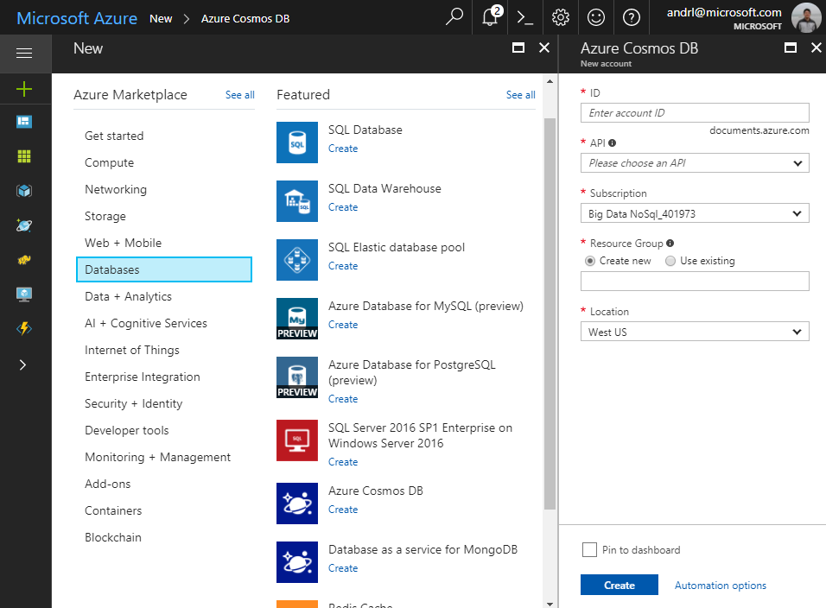
Account
Database
Container
Item

Slide 38
Account
Database
Container
Item

Slide 39
Account
Database
Container
Item

Slide 40
Account
Database
Container
Item

Slide 41
Account
Database
Container
Item

Slide 42
Account
Database
Container
Item

Slide 43
Account
Database
Container
Item

Slide 44
Account
Database
Container
Item

Slide 45
Account
Database
Container
Item

Slide 46
Account
Database
Container
Item

Slide 47
Account
Database
Container
User
Item
Permission

Slide 48
Account
Database
Container
=
Collection
Graph
Table
Item

Slide 49
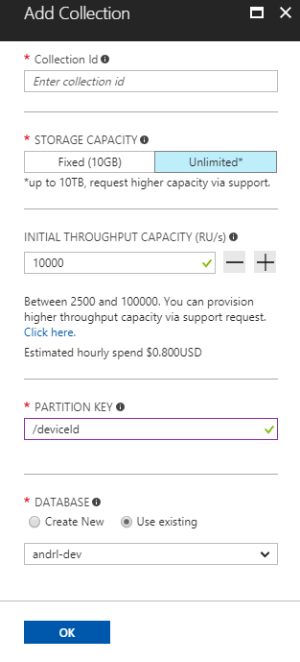
Account
Database
Container
Item

Slide 50
Account
Database
Container
Item

Slide 51
Account
Database
Container
Note: Throughput can also be shared across a set of collections
Item

Slide 52
Account
Database
Container
Item

Slide 53
Account
Database
Container
Item

Slide 54
Account
Database
Container
Item
Sproc
Trigger
UDF

Slide 55
Account
Database
Container
Item
Sproc
Trigger
UDF
Conflict

Slide 56
System Internals

Slide 57
System design (logical)
Tenants
Follower
Follower
Collections
Graphs
Leader
Forwarder
Tables
Replica set
To a remote resource partition(s)
Container
Container
Container
Resource Partition
A consistent, highly available, and resource governed coordination primitive
Consists of a replica set with each replica hosting an instance of database engine
Uniquely belongs to a tenant
Owns a set of keys
Containers
…
Resource Partitions

Slide 58
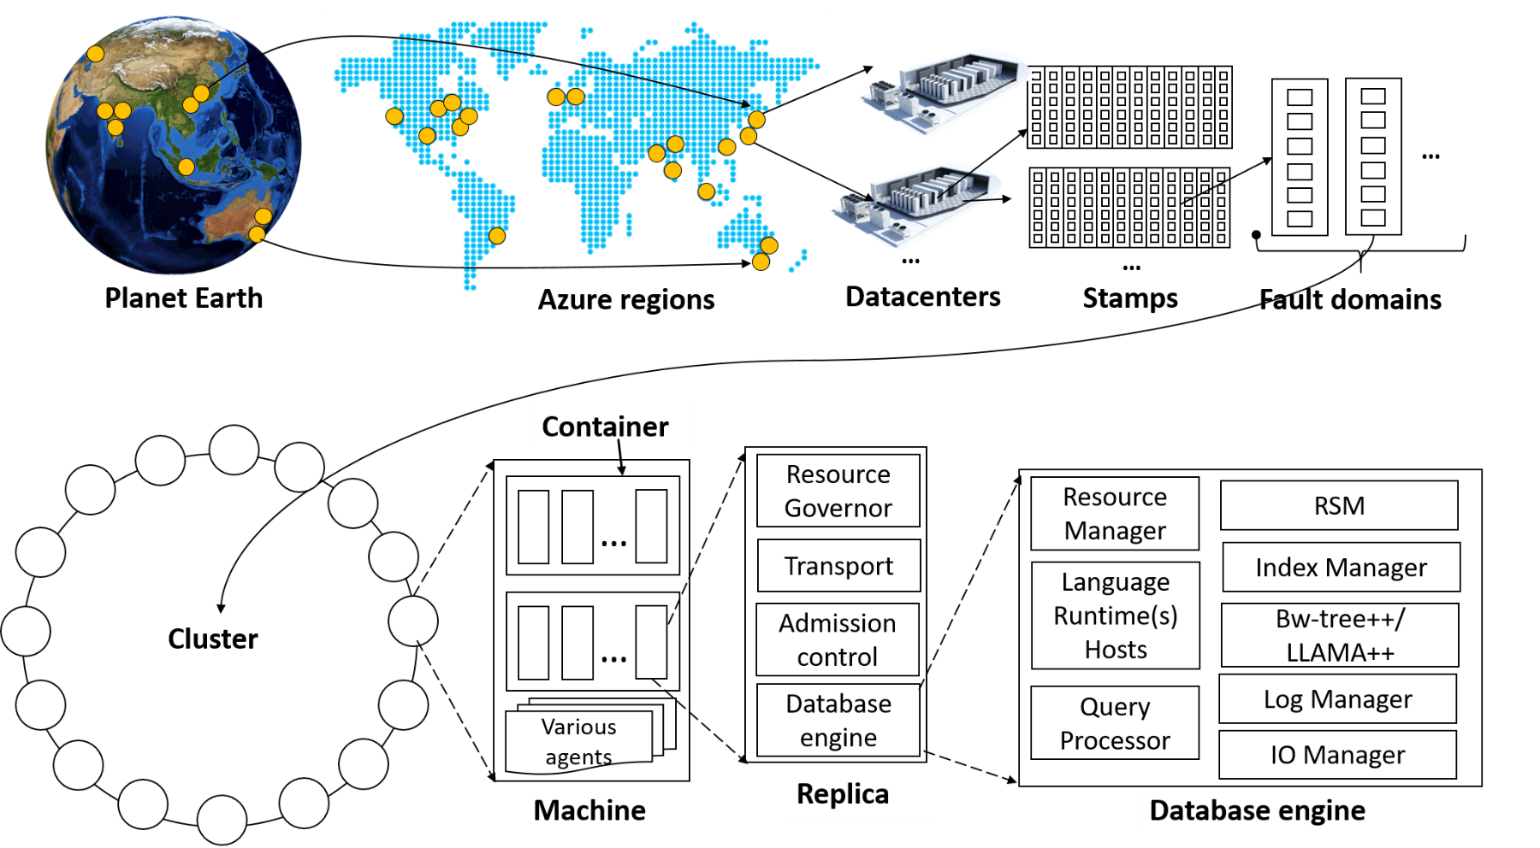
System topology (behind the scenes)

Slide 59
Global Distribution

Slide 60
Why Global Distribution
High Availability
Automatic and Manuel Failover
Multi-homing API removes need for app redeployment
Low Latency (anywhere in the world)
Packets cannot move fast than the speed of light
Sending a packet across the world under ideal network conditions takes 100’s of milliseconds
You can cheat the speed of light – using data locality
CDN’s solved this for static content
Azure Cosmos DB solves this for dynamic content

Slide 61
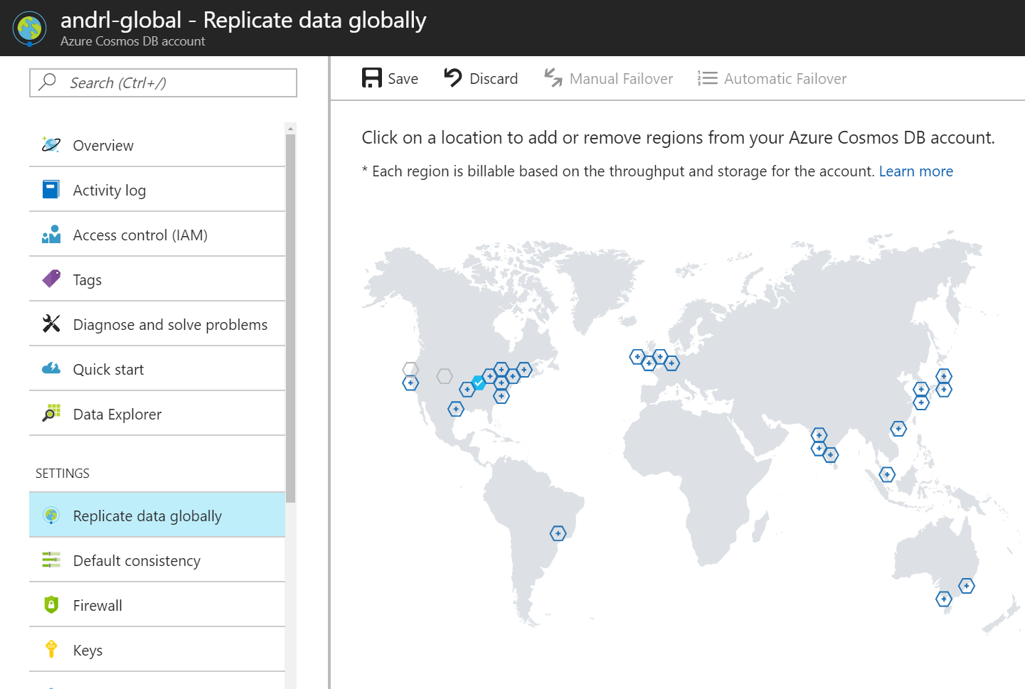

Slide 63
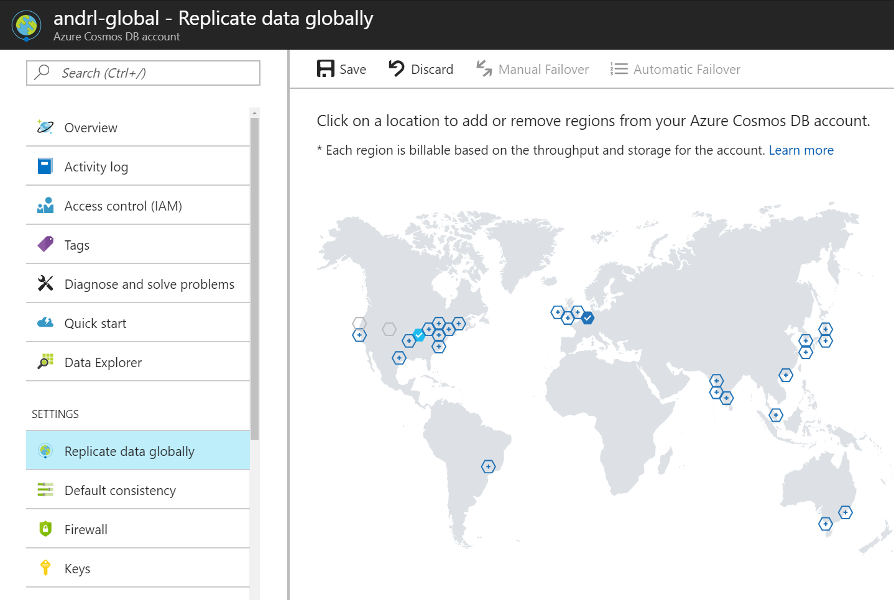

Slide 64


Slide 66
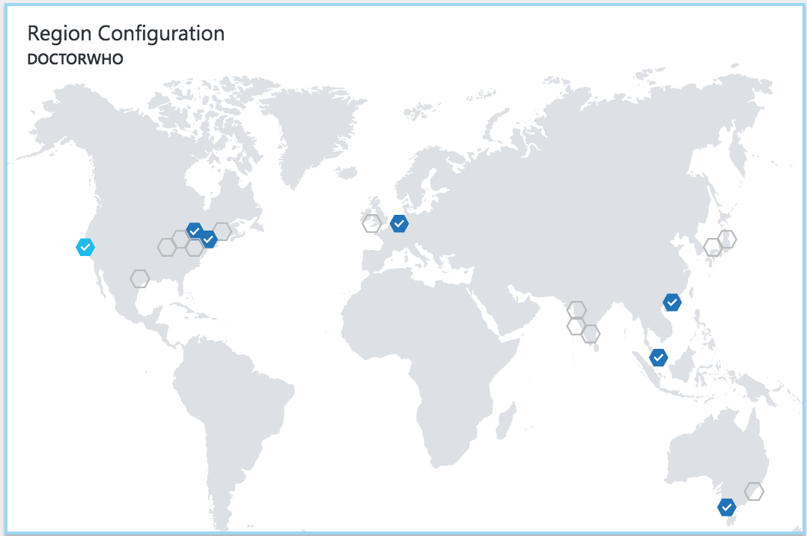


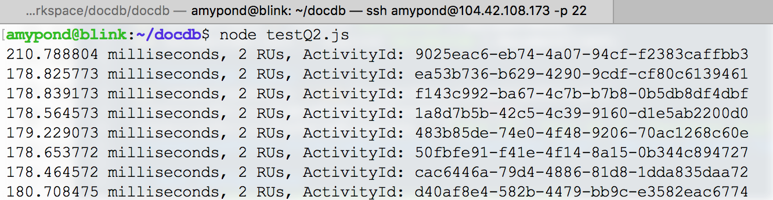

Slide 67
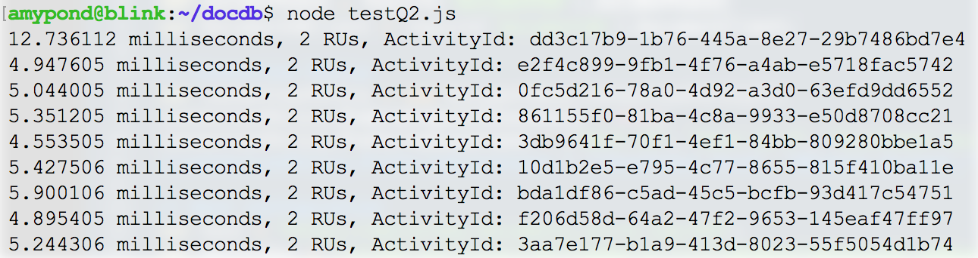

Slide 68
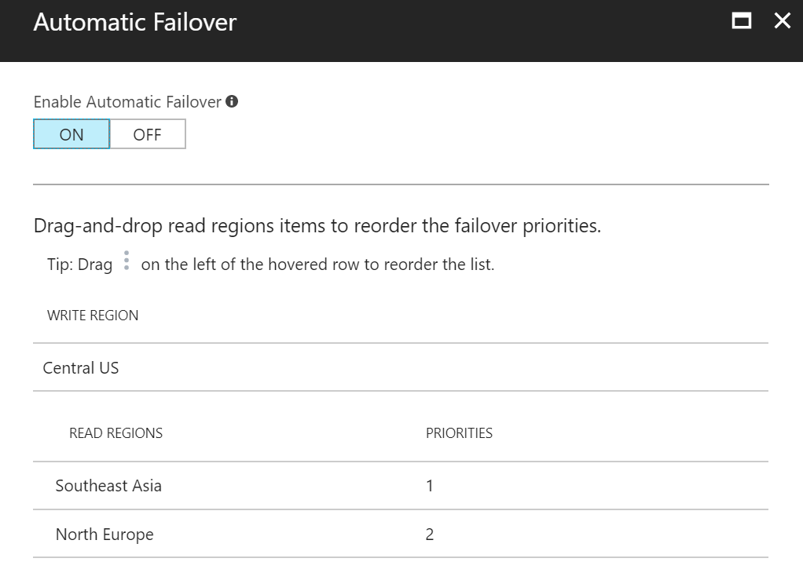

Slide 70
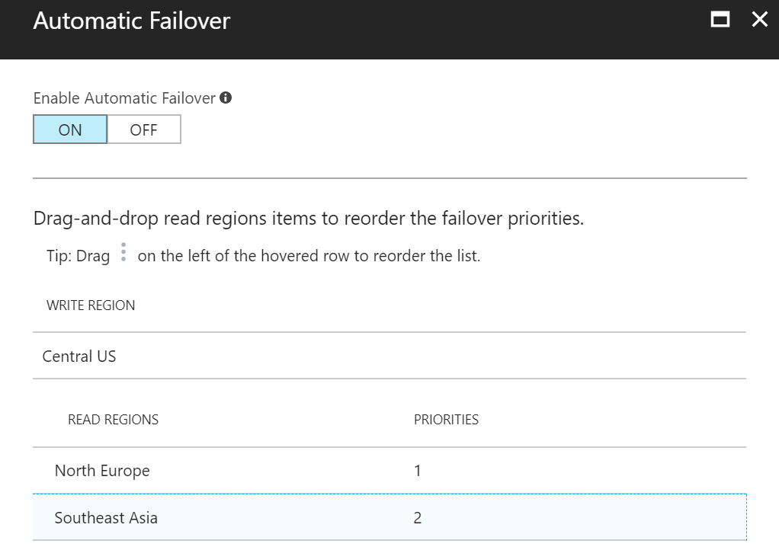
Note: For multi-master enabled accounts –
The priority list indicates which is the designated “hub” region for resolving write conflicts.

Slide 71
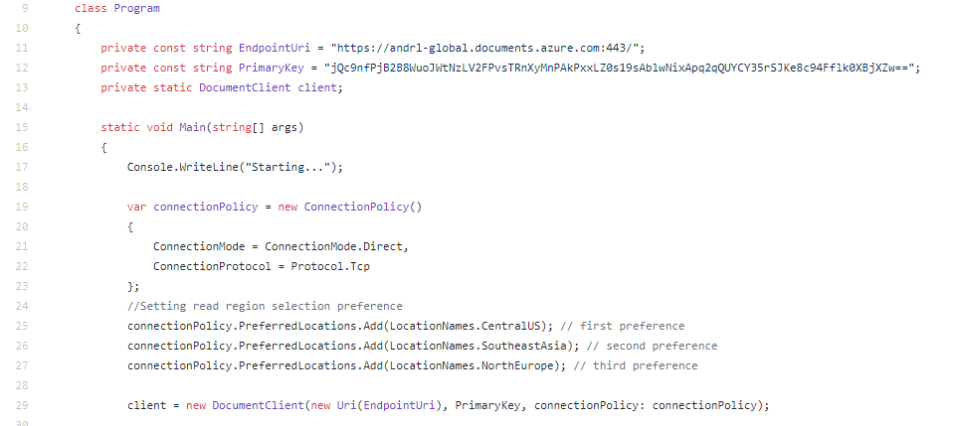

Slide 72
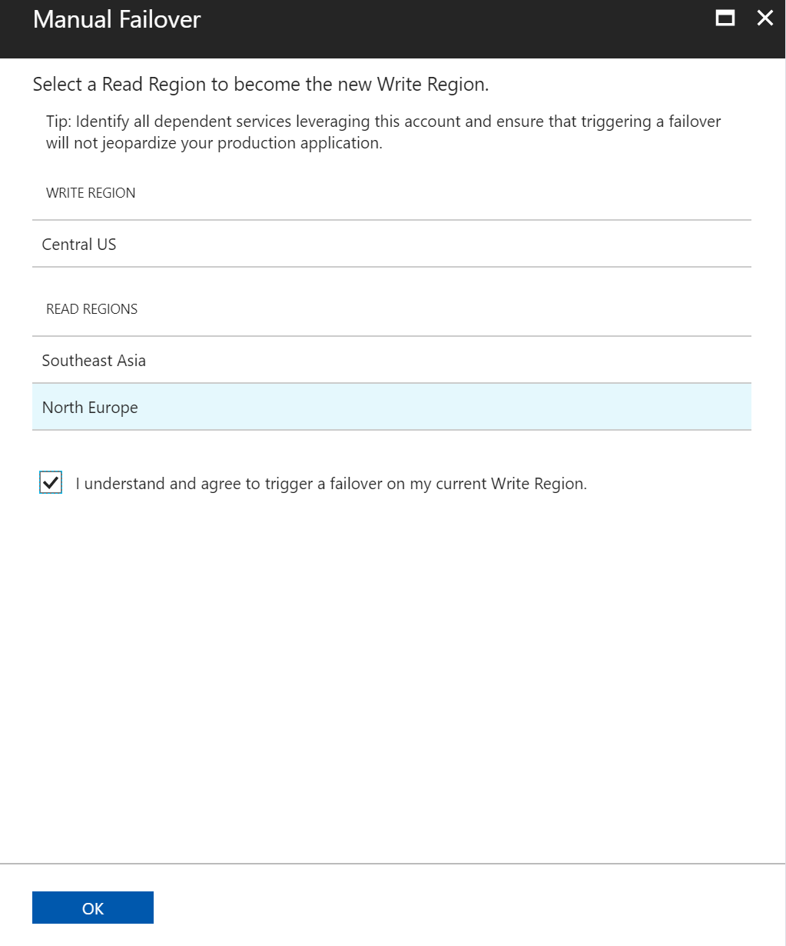

Slide 73
Consistency

Slide 74
ACID != CAP
Consistency w.r.t. Transactions is NOT the same thing as Consistency w.r.t. Replication.
this is about moving from one valid state to another for a single given tx
this about getting a consistent view across replicated copies of data

Slide 75
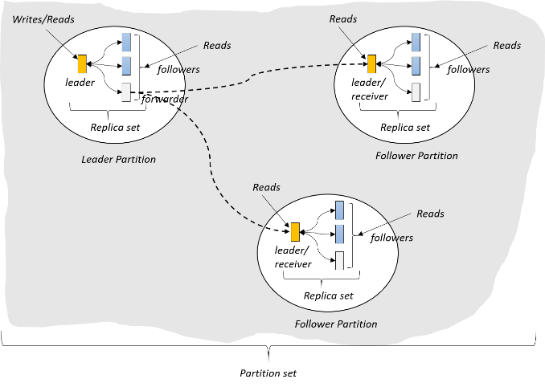
(West US)
(East US)
(North Europe)

Slide 76
Value = 5
Value = 5
Value = 5

Slide 77
Value = 5 6
Update 5 => 6
Value = 5
Value = 5

Slide 78
Value = 5 6
Update 5 => 6
Value = 5 6
Value = 5
What happens when a network partition is introduced?

Slide 79
Value = 5 6
Update 5 => 6
Value = 5 6
Value = 5
What happens when a network partition is introduced?
Reader: What is the value?
Should it see 5? (prioritize availability)
Or does the system go offline until network is restored? (prioritize consistency)

Slide 80
Brewer’s CAP Theorem: impossible for distributed data store to simultaneously provide more than 2 out of the following 3 guarantees:
Consistency, Availability, Partition Tolerance

Slide 81
Latency: packet of information can travel as fast as speed of light.
Replication between distant geographic regions can take 100’s of milliseconds
Value = 5 6
Update 5 => 6
Value = 5 6
Value = 5

Slide 82
Reader A: What is the value?
Value = 5 6
Update 5 => 6
Value = 5 6
Value = 5
Reader B: What is the value?

Slide 83
Reader A: What is the value?
Value = 5 6
Update 5 => 6
Value = 5 6
Value = 5
Reader B: What is the value?
Should it see 5 immediately? (prioritize latency)
Does it see the same result as reader A? (quorum impacts throughput)
Or does it sit and wait for 5 => 6 propagate? (prioritize consistency)

Slide 84
PACELC Theorem: In the case of network partitioning (P) in a distributed computer system, one has to choose between availability (A) and consistency (C) (as per the CAP theorem), but else (E), even when the system is running normally in the absence of partitions, one has to choose between latency (L) and consistency (C).

Slide 85

Programmable Data Consistency
Choice for most distributed apps
Strong consistency High latency
Eventual consistency, Low latency

Slide 86
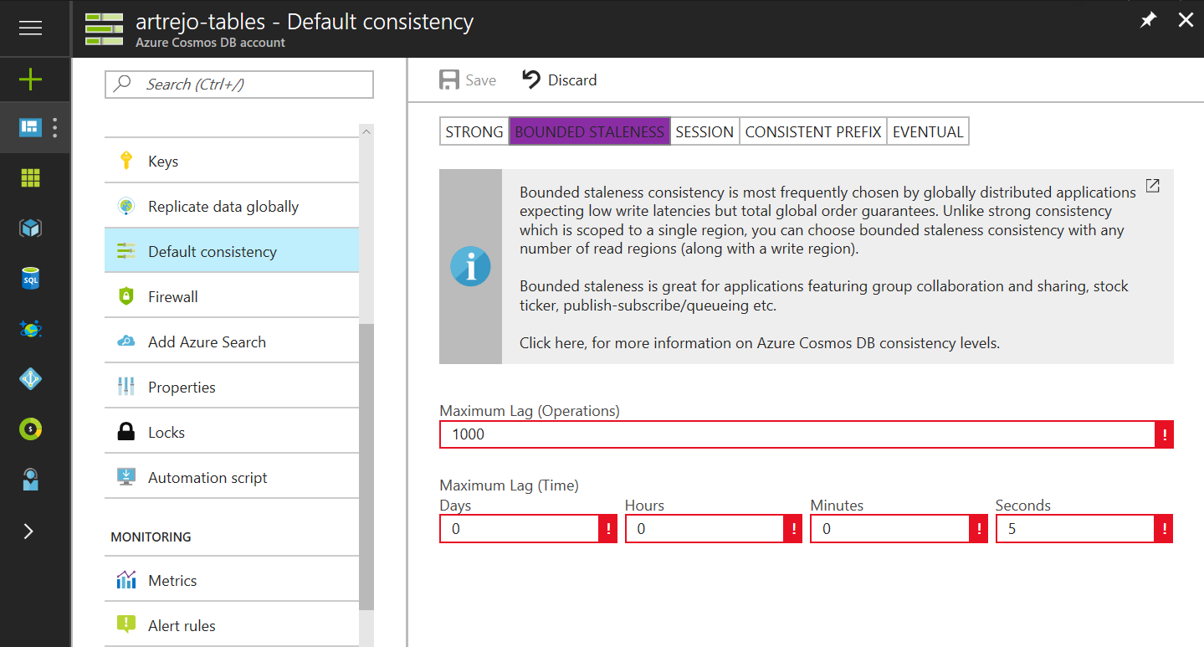
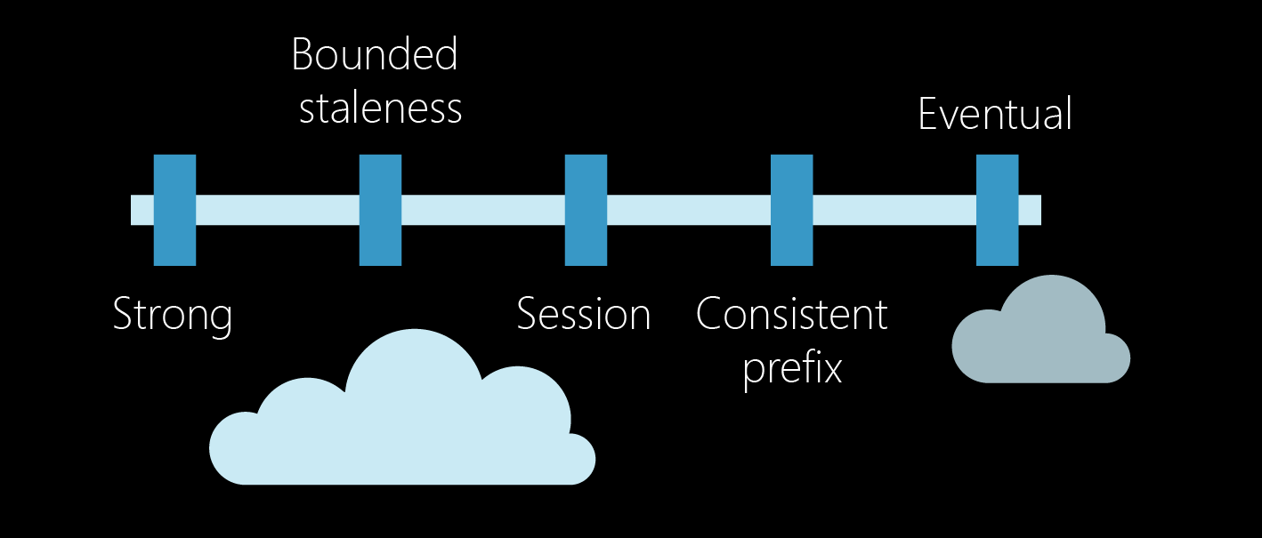
Well-defined consistency models
Intuitive programming model
5 Well-defined, consistency models
Overridable on a per-request basis
Clear tradeoffs
Latency
Availability
Throughput

Slide 87
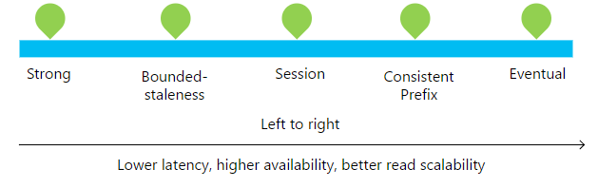

Slide 88
Consistency Level | Guarantees
Strong | Linearizability (once operation is complete, it will be visible to all)
Bounded Staleness | Consistent Prefix. Reads lag behind writes by at most k prefixes or t interval Similar properties to strong consistency (except within staleness window), while preserving 99.99% availability and low latency.
Session | Consistent Prefix. Within a session: monotonic reads, monotonic writes, read-your-writes, write-follows-reads Predictable consistency for a session, high read throughput + low latency
Consistent Prefix | Reads will never see out of order writes (no gaps).
Eventual | Potential for out of order reads. Lowest cost for reads of all consistency levels.

Slide 89
Bounded-Staleness: Bounds are set server-side via the Azure Portal

Slide 90
Session Consistency: Session is controlled using a “session token”.
Session tokens are automatically cached by the Client SDK
Can be pulled out and used to override other requests (to preserve session between multiple clients)
string sessionToken;
using (DocumentClient client = new DocumentClient(new Uri(""), ""))
{
ResourceResponse<Document> response = client.CreateDocumentAsync(
collectionLink,
new { id = "an id", value = "some value" }
).Result;
sessionToken = response.SessionToken;
}
using (DocumentClient client = new DocumentClient(new Uri(""), ""))
{
ResourceResponse<Document> read = client.ReadDocumentAsync(
documentLink,
new RequestOptions { SessionToken = sessionToken }
).Result;
}

Slide 91
Consistency can be relaxed on a per-request basis
client.ReadDocumentAsync(
documentLink,
new RequestOptions { ConsistencyLevel = ConsistencyLevel.Eventual }
);

Slide 92
Security & Compliance
Always encrypted at rest and in transit
Encryption@ Rest – AES256
Encryption @ Transit – SSL / TLS
Fine grained “row level” authorization
User/Permissions with Resource Tokens
Network security with IP firewall rules and VNET
Comprehensive Azure compliance certification:
ISO 27001, ISO 27018, EUMC, HIPAA
PCI, SOC1 and SOC2
FEDRAMP, HITRUST

